Slide 1
Ali Shari’ti
Faisal Alsulaimi

Slide 2
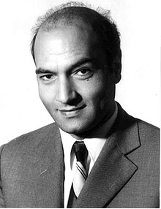
Ali Shariati
he was born in 1933 in Mashhad
PhD in sociology in 1964 from Sorbonne University
Assassinated in 1977

Slide 3
His books and lectures
He wrote books about philosophy, society, Ethics, and religion
He always wanted change and his writings inspired the Iranian revolution in 1979.
Red Shi’ism vs Black Shi’ism
Humanism and Islam
Ethics For the Youth
Islam and the West

Slide 4
Red Shi’ism vs Black Shi’ism
Red Shi’ism is the pure form of religion, which is concerned with social justice and salvation.
Black Shi’ism is the deviated form of religion, which is controlled by the state and the clergy.
“Our issuance of judgments is always, and unfortunately, based on a one-sided view. We always look at things with one eye. It is more regrettable that we all suffer from this problem, whether we are extremists or open-minded”

Slide 5
Humanism and Islam.
6 lectures in 1968.
The creation story in Islam.
The importance of freedom.
Are we prisoners of our own?

Slide 6
Ethics for the Youth
An ethical book for the youth, it was meant for third are fourth grade.
The book talked about
Freedom
Rights and Duties in family and society
Following rules
“people say time is money, but that is not true, with time you can make money, but you will never make time out of money.”

Slide 7
Islam and the West
Capitalism and Marxism are too materialistic
Human beings are unique
Humans have free will
Consciousness
Self-awareness
Creativity
Wishful and look for perfection

